Slide 1



What is Agentic AI?
Agentic AI is a framework for goal-oriented behaviour under limited supervision, built around autonomous AI agents.
In multi-agent systems, each agent is responsible for a specific subtask, collaborating or coordinating with others to collectively achieve the overall objective.

Slide 2
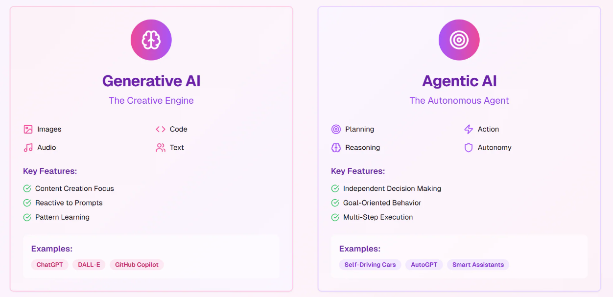
Generative AI Vs Agentic AI
Ethical Challenges in AI

Slide 3
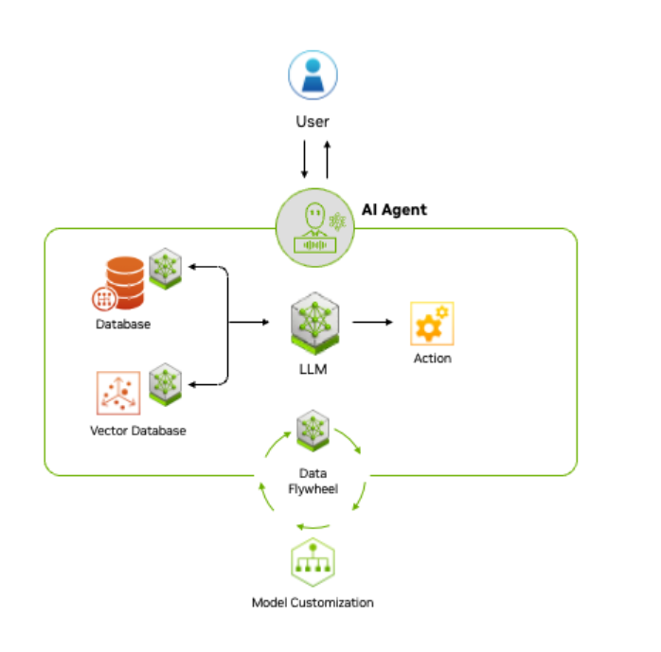
How Agentic AI Work
Agentic AI uses a four-step process for problem-solving:
Perception:
gather and process data
extracting meaningful features, recognizing objects.
Reasoning:
understands tasks, generates solutions and coordinates specialized models through LLM.
Retrieval-Augmented Generation (RAG) to access proprietary data sources and deliver accurate, relevant outputs.
Act:
integrating with external tools and software via application programming interfaces.
execute tasks based on the plans.
Learn:
continuously improves through a feedback loop, or “data flywheel,”

Slide 4

Key Characteristics of Agentic AI
1
Goal-Oriented
2
Autonomous
Agentic AI systems are designed with specific goals in mind, driving their actions and decisions.
They can operate independently, making decisions and taking actions without constant human intervention.
3
Self-Learning
4
Contextual Awareness
Agentic AI continuously learns and improves its performance based on data and feedback.
They can understand and adapt to changing contexts, making decisions based on real-time information.

Slide 5
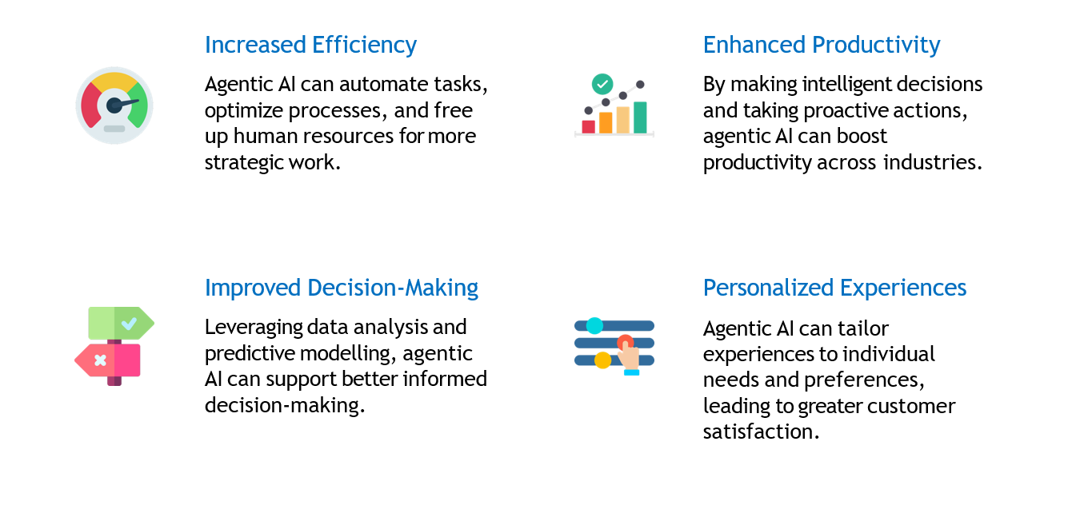
Benefits of Agentic AI

Slide 6




Agentic AI in Application: Use Cases and Examples
Manufacturing
Healthcare
Automated production lines, predictive maintenance, and quality control.
Personalized treatment plans, drug discovery, and patient monitoring.
Finance
Education
Fraud detection, algorithmic trading, and risk management.
Personalized learning, adaptive tutoring systems, and automated grading.

Slide 7
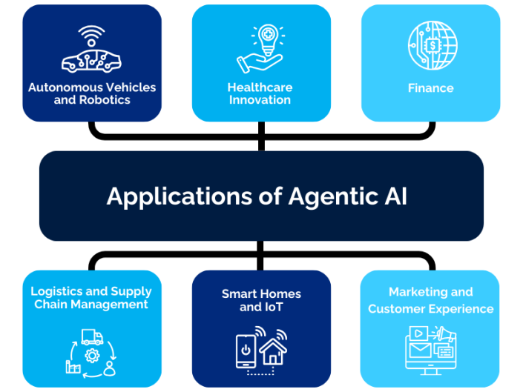

Slide 8
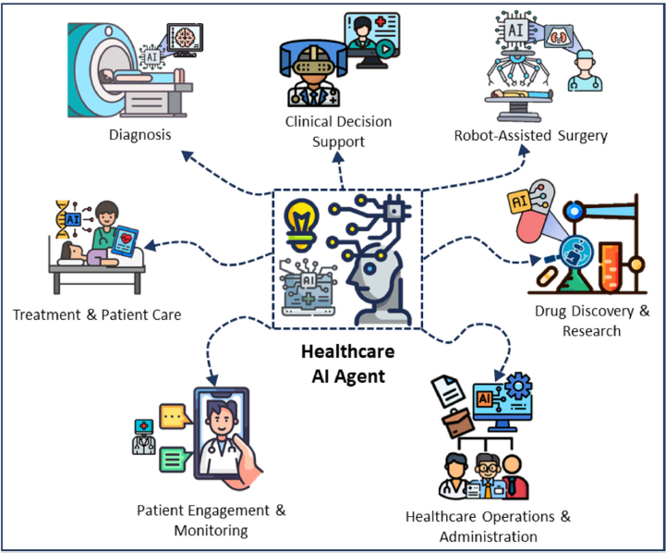
Agentic AI in Healthcare
Related Work (N.Karunanayake [3] ):
Research gap:
Proposed a multi-agent healthcare AI framework integrating diagnostics, robotic surgery, and patient monitoring.
Utilized context-aware decision-making with patient vitals, medical imaging, and multi-modal data fusion.
Incorporated reinforcement learning-based adaptive control loops for dynamic treatment optimization.
Demonstrated improved diagnostic accuracy and reduced surgical errors in simulations.
No ethical explainability or accountability framework.
Data privacy and secure agent communication not addressed.
Evaluation limited to controlled environments without large-scale deployment.

Slide 9
Agentic AI in Elderly care
Related Work(Khalil et al.[4] ) :
Research gap:
Designed an autonomous multi-agent framework for elderly cognitive, medical, and social support.
Implemented cognitive support agents for memory recall, reminders, and exercises.
Integrated IoT-enabled health monitoring devices for real-time physiological tracking.
Applied context-aware scheduling for daily activities and intervention.
Lacks personalization mechanisms for user-specific needs.
No dynamic adaptation for evolving health conditions.
Limited coverage of ethical and emotional context handling.

Slide 10
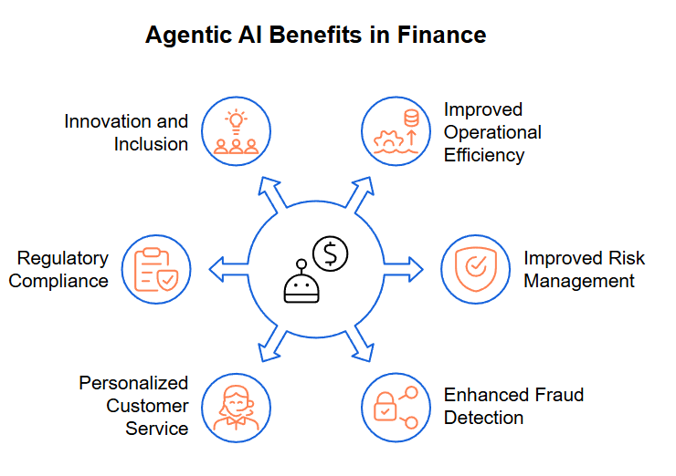
Agentic AI in Finance
Related Work (Deshpande et al.[5] ):
Research gap:
Developed autonomous financial agents for fraud detection, market forecasting, and portfolio management.
Applied machine learning algorithms for real-time analytics and predictive modelling.
Used optimization techniques for portfolio rebalancing under market volatility.
Highlighted operational benefits through automation of decision-making in finance.
No risk mitigation strategies for extreme market fluctuations.
Missing regulatory compliance frameworks for AI-based financial systems.
Lacks trust and explainability mechanisms for high-stakes operations.

Slide 11
Agentic AI in Smart Cities / Infrastructure
Related Work (Seilani et al.[6] ) :
Research gap:
Covered applications in energy optimization, traffic control, and waste management.
Discussed AI interoperability across urban infrastructure components.
Conducted a systematic review of agent-based systems for urban management.
Showcased potential for autonomous resource allocation for sustainable cities.
Absence of citizen trust-building mechanisms.
Lacks evaluation of policy and socio-technical barriers.
No real-world case study demonstrations.
.

Slide 12
Agentic AI in Cybersecurity
Related Work (N. Kshetri [7] ):
Research gap:
Developed real-time intrusion detection systems with adaptive defence.
Focused on automation in SOCs to reduce incident response time.
Proposed autonomous cybersecurity agents for proactive threat detection.
Addressed evolving cyber threat landscapes through adaptive models.
Missing explainability and verifiability of AI-driven actions.
No human oversight integration for mission-critical scenarios.
Limited discussion on trust and audit mechanisms.

Slide 13
Agentic AI in Scientific Research
Related Work(Gridach et al. [8] ) :
Research gap:
Surveyed agentic AI systems for hypothesis generation and experiment execution.
Integrated literature review automation and data analysis agents.
Proposed multi-agent collaboration for complex scientific workflows.
Linked AI research assistants with scientific databases and knowledge graphs.
No reproducibility frameworks for AI-driven science.
Lacks ethical reasoning and governance guidelines.
Missing human–agent collaboration standards.

Slide 14
Conclusion
Agentic AI marks a significant advancement over conventional AI, integrating autonomy, goal-oriented reasoning, and adaptive learning to tackle complex, dynamic problems. With applications ranging from healthcare and finance to smart infrastructure and cybersecurity, it offers the potential for greater efficiency, innovation, and informed decision-making. Yet, to fully harness its benefits, it is essential to overcome ethical, governance, and trust challenges, ensuring its deployment remains safe, transparent, and socially accountable.

Slide 15
Future work
As a future direction, I intend to undertake novel research on integrating Agentic AI into autonomous driving systems, with emphasis on real-time adaptive learning, cooperative multi-agent traffic optimization, ethical and context-aware decision-making, and proactive perception–planning integration to advance safety, efficiency, and resilience in intelligent transportation ecosystems.

Slide 16
Refrences
[1] D. B. Acharya, K. Kuppan, and B. Divya, “Agentic AI: Autonomous Intelligence for Complex Goals—A Comprehensive Survey,” IEEE Access, vol. 13, pp.18912–18937, Jan. 2025. Publisher: IEEE.
[2] P. D. Sawant, “Agentic AI: A Quantitative Analysis of Performance and Applications,” Journal of Advanced Artificial Intelligence, vol. 3, no. 2,pp. 132-140, May 2025. Publisher: Journal of Advanced AI Publications.
[3] N. Karunanayake, “Next-generation Agentic AI for Transforming Healthcare,” Informatics and Health, vol. 2, pp. 73–83, Apr. 2025. Publisher: HealthTech Informatics Press.
[4] R. A. Khalil, K. Ahmad, and H. Ali, “Redefining Elderly Care with Agentic AI Challenges and Opportunities,” IEEE Transactions on Medical Systems, vol. 38,no. 3, pp. 215–228, Jul. 2025. Publisher: IEEE.
[5] S. Chugh and A. V. Deshpande, “Opportunities and Challenges of Agentic AI in Finance,” Journal of Emerging Technologies and Innovative Research, vol. 12, no. 3, pp. 254–262, Mar. 2025. Publisher: JETIR.
[6] S. Hosseini and H. Seilani, ”The role of agentic AI in shaping a smart future: A systematic review,” Array, vol. 25, p. 100399, 2025, doi: 10.1016/j.array.2025.100399. Publisher: Elsevier.
[7] N. Kshetri, ”Transforming cybersecurity with agentic AI to combat emerging cyber threats,” Telecommunications Policy, vol. 49, no. 6, p. 102849, 2025, doi: 10.1016/j.telpol.2025.102849. Publisher: Elsevier.
[8] M. Gridach et al., “Agentic AI for Scientific Discovery: A Survey of Progress, Challenges, and Future Directions,” Proceedings of ICLR 2025, Mar. 2025. Publisher: ICLR.

